Slide 1
How Sweet is the Terminal?
Cybersecurity
Lesson 3.2

Slide 2

By the end of today’s class, you will be able to:
1
Identify and explain the structure of a terminal command.
2
Explain how options modify the default behavior of a terminal command.
3
Use commands like head, tail, more, and less to preview files.
4
Combine multiple commands in sequence to accomplish relevant IT tasks.

Slide 4
Terminal Review
Commands for navigating a file directory:
pwd | Displays the current working directory
ls | Lists the directories and files in the current directory
cd | Navigates into a directory
cd ../ | Navigates out of a directory
clear | Clears the terminal history on the page

Slide 5
Terminal Review
Commands for making and removing files and directories:
mkdir | Creates a new directory
rmdir | Removes a directory
touch | Creates an empty file
rm | Removes a file
Commands for moving and copying files:
cp | Copies files to a new location
mv | Moves files to a new location

Slide 6

Preview Commands

Slide 7
Security and IT professionals often preview the contents
of a file.

Slide 8
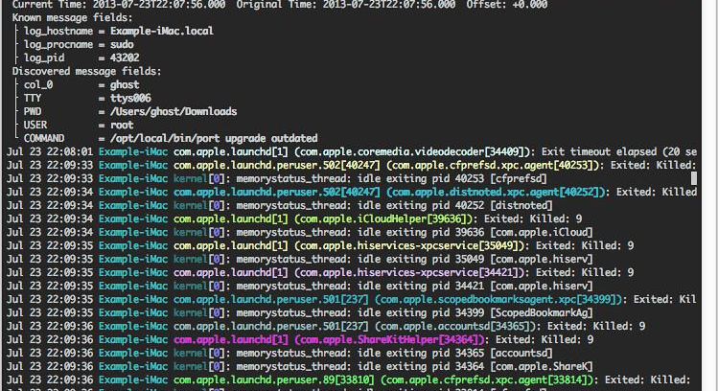
Preview Commands
Security Professional Examples
The security administrator
needs to preview the top
10 lines of an email.
The network administrator
needs to preview the bottom
of a log file.

Slide 9
More, Less, Head, and Tail
To preview and scroll through a whole file, use the more or less commands.
more | View a file one page at a time. Space bar moves you to the next page.
less | Similar to more, but it allows more flexibility. You can scroll forward and backward one line at a time, and it supports horizontal scrolling.
To preview a file by a certain number of lines, use the head or tail commands.
head | Displays the top 10 lines of a file
tail | Displays the bottom 10 lines of a file

Slide 10

Modify the Preview
head and tail commands preview 10 lines by default. This number can be changed easily.
The syntax for head is:
head -number file
For example, the following shows the top 50 lines in logfile.txt.
:
head -50 logfile.txt
The same syntax applies for the tail command.

Slide 11
Preview Commands

Slide 12

Oh Henry, What Did You Do?
Continue in your role as a security analyst at Candy Corp.
Your manager identified two employees who may be working with Sugar Corp—Henry and Ruth—and quickly pulled some files from their computers.
You must preview the files to determine which have readable text data that can be used for analysis.
15 Minutes

Slide 15
Data Streams and the
cat Command

Slide 16
cat (concatenate) combines files and displays the results.

Slide 17

The cat Command
Security and IT Professionals often have to combine files
1.txt:
A B C D
2.txt:
E F G H
cat 1.txt 2.txt
A B C D
E F G H
Note: This command does not save the results. To save results of the cat command, you have to redirect the data stream.

Slide 18
A data stream describes channels of data as they are processed and moved through a system.

Slide 19

Data Streams
Move data from one process or program to another
Most common data streams:
  stdin
  stdout
Input data streamed using stdin
Output data streamed using stdout

Slide 20

cat with >
cat 1.txt 2.txt > combined_1_and_2.txt
The command combines two separate files, 1.txt and 2.txt, into a single file called combined_1_and_2.txt.
If combined_1_and_2.txt already exists, it will overwrite the file with the combined data from 1.txt and 2.txt.

Slide 21
cat with >
cat 3.txt 4.txt >> combined_3_and_4.txt
The command combines two separate files, 3.txt and 4.txt, into a single file called combined_3_and_4.txt.
If it already exists, it will append the combined data from 3.txt and 4.txt to the end of the file.

Slide 22
cat and Data Streams
cat 1.txt 2.txt > combined_1_and_2.txt
cat takes data directly from stdin and directs it to stdout.
1.txt and 2.txt are sent to stdin.
cat is taking stdin, concatenating the data, and sending it to stdout.
The result of combining 1.txt and 2.txt is stdout.
stdout is redirected and written to a file called combined_1_and_2.txt.

Slide 23

Instructor Demonstration
cat

Slide 24
Internal Investigation: Find the Kit cat Burglar
Continue in your role as a security analyst at Candy Corp.
Your manager believes Henry and Ruth are sharing secret recipes and collected some files from their computers to help you build your case.
You must analyze this additional data and prepare a combined evidence file for the local authorities.
20 Minutes

Slide 28
Command-Line Structure

Slide 29
Command-Line Structure
We’re familiar with the following structure:
<command> <argument>
Example:
touch myfile
Command
Argument

Slide 30
IT professionals often need to run commands with more specific parameters.

Slide 31



Command-Line Parameters
Commands have options that can modify their behavior.
01
02
03
Add an option to modify the command's default behavior
Add an option and an argument to modify the default behavior on files or directories
Add options that require their own arguments, called parameters
Notes:
Shutterstock_792833623 shutterstock_693068344 shutterstock_693068344.png

Slide 32

Method 1
Add an option to modify the command’s default behaviour.
Use the command ls -S to list files by size
By default, ls simply lists the files in the current directory. The -S option modifies that behaviour to list by size, largest first.
The syntax:
  ls is the command.
  -S is the option.
ls -S

Slide 33
Method 1
Add an option to modify the command’s default behaviour.
Keep in mind:
Options always use a hyphen.
Options, just like commands, are case sensitive:
  -s and -S provide different results.
Options have different uses for different commands:
  ls -s will print the size of each file.
  cat -s will suppress repeated empty output lines.
ls -S
ls -s
cat -s

Slide 34
Method 2
Add an option and an argument to modify the default behavior.
This command displays the line numbers of logfile1.txt.
By default, the cat command concatenates multiple files or displays the contents of a single file.
Adding the option -n modifies the behavior by displaying the line numbers preceding each line.
cat -n logfile1.txt

Slide 35
Method 3
Add options that require their own arguments, called parameters.
This command previews the first four lines of logfile.txt.
By default, head displays the top ten lines of a file.
The option -n changes the number of lines displayed.
  -n requires a parameter specifying the number of lines.
  Parameters provide additional details on how to modify a command’s default behavior.
head -n 4 logfile.txt

Slide 36

Demonstration Scenario
We are security analysts at ACME Corp who must clean up some evidence files, as server space is low.
We need to delete the three largest evidence files, as long as they don’t contain the user Sheila.
The log files are not more than 40 lines each.
Notes:
shutterstock_1888488028

Slide 37
Instructor Demonstration
Options

Slide 38

Welcome to Man Pages

Slide 39
IT and security professionals can
learn and manage options with man (manual) pages.

Slide 40
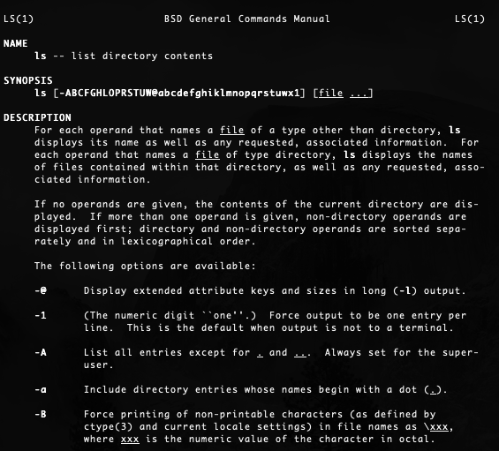
Man Pages
Each man page contains:
Name of the command
Synopsis (includes syntax)
Description
Options and option parameters
The command:
man <command>
For example:
man ls

Slide 41

Demonstration Scenario
We are security analysts at ACME Corp and our manager asks you to count the number of server logins on October 13, 2019, as they believe it is higher than usual
They tell us to use the command wc to count the logins on the server login file.
We have not used the wc command before and will need to use the man page to learn how.
Notes:
shutterstock_1888488028

Slide 42
Instructor Demonstration
Man Pages

Slide 43
Learn New Commands
Continue in your role as a security analyst at Candy Corp.
There has been a network attack on Candy Corp’s websites.
Your manager provides you with log files for each of the websites.
Each log file contains the IP addresses that were connecting to that website on the day of the attack.
To determine which website was the main target, you will count the IP addresses in each of these log files.
20 Minutes

Slide 46
Command-Line Navigation
Data streams and the cat command
Using wc for counting
Man pages

